Slide 1
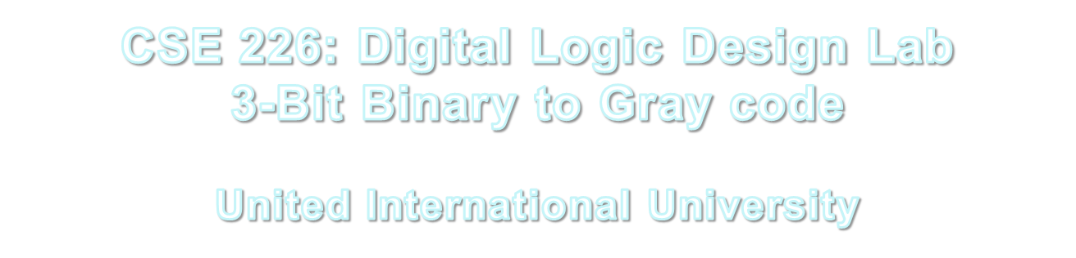

Slide 2
What to do
Find out the relation between 3-bit binary to gray code
Binary A B C | Gray Code X Y Z
0 0 0 | 0 0 0
0 0 1 | 0 0 1
0 1 0 | 0 1 1
0 1 1 | 0 1 0
1 0 0 | 1 1 0
1 0 1 | 1 1 1
1 1 0 | 1 0 1
1 1 1 | 1 0 0
CSE 226: Digital Logic Design Lab

Slide 3
How to proceed
Now consider X = F (A, B, C)
        Y = F (A, B, C)
        Z = F (A, B, C)
Draw 3 K-maps for X, Y and Z independently
CSE 226: Digital Logic Design Lab

Slide 4
Writing Report
The report should contain the following:
Binary representation of 3-Bit Gray code
The K-maps you have drawn and the minimized functions for X, Y and Z
The gate diagrams
List of ICs you are using
CSE 226: Digital Logic Design Lab

